Slide 1


An Introduction to Spring AI
AHEAD Tech on Tap
August 16, 2024
Steve Mitchell, Principal Technical Consultant, AHEAD
smitchell.github.io
stevecmitchell

Slide 2
Table of contents
01
02
03
AI Background
Spring AI
Ollama
04
05
Spring AI Demo
Conclusions
What led to generative AI
Spring AI simplifies AI for Java developers
How Ollama makes it easy to run AI locally
Hands on with Spring AI and Ollma
Your path forward with Spring AI

Slide 3
Generative AI
01
How Generative AI will affect Spring developers

Slide 4
How did we get here?
Personal Computers
World Wide Web
Mobile Devices
Generative AI with LLMs
1978 1995 2008 2020
Affordable Compute
Distribution of information
Ubiquitous access
Access to generative artificial intelligence
See "The Turing Lectures: The future of generative AI" to learn about the past, present, and future of AI: https://youtu.be/2kSl0xkq2lM?si=21JsY1OhOhsOICDO
Notes:
Before generative AI there was predictive AI, used to observe can classify patterns in content. Generative AI can generate and image or description of a subject on its own when prompted.

Slide 5
What is Generative AI
AI that generates new content
Large Language Model
Predictions
Generative AI is a type of AI that creates new content based on existing content. This is as opposed to the AI technology that came before it, like machine learning, deep learning, neural networks, and others.
A (LLM) large language model is trained on vast amount of content, typically scraped from the Web, books, papers, etc. Content is transformed into a searchable statistical model.
When prompted with a question, the LLM uses the statistical model to predict the answer, like the next word in a sentence.

Slide 6
The Catalyst for Generative AI
Input
Output
In 2017, six data scientists from Google published a paper introducing transformers for machine learning
Transformers
Encoder
Decoder
Transform Layers
State
Transform Layers

Slide 7
Attention is all you need
Transformers
Scalability
Performance
Generality
Attention Mechanism
Spurred R&D
Transformers replaced Recurrent Neural Networks
Transformers are parallel, not serial like RNNs
Faster performance of sequence modeling
Previous models were often task-specific
Allows models to focus on relevant parts on input
The paper caused surge of research and new LLMs
Vaswani, A., Shazeer, N., Parmar, N., Uszkoreit, J., Jones, L., Gomez, A. N., ... & Polosukhin, I. (2017). Attention is all you need. In Advances in Neural Information Processing Systems (pp. 5998-6008).

Slide 8
A Tiny Sample of LLMs
ChatGPT
Mistral
T5
DALL-E
Codex
Llama 3
General-purpose language generation tasks
Code generation, text translation, complex reasoning
Text to text generation, like translations, chatbots, reading comprehension problem
Image generation from textual descriptions
Trained on code snippets for code generation and understanding
Excels in tasks like text classification, sentiment analysis, and question answering.

Slide 9
Some AI Model Constraints
Stale data
Stateless API
Not trained on your data
Training data may have stopped months ago
The model doesn’t hold conversation state
A model isn’t very useful with your corporate specific data
Limited prompt size
Prone to hallucinations
There are limits to the amount of data you can send or receive from the LLM (e.g. 4,000 tokens)
A model may generate false information if it doesn’t have the answer

Slide 10
Prompts are the SQL for AI
Try out this prompt using your own career goals
S
## SYSTEM
You are a career coach. You give concise career advice and create learning plans. Return the response in Markdown format.
## USER
I am an experienced Java developer. What can I do to achieve my career goals? Consider the provided CAREER GOALS in your response.
## CAREER GOALS
I want to apply my Java experience to do cloud native development.
I want to get better at distributed data architecture.
Notes:
LLM models accept markdown syntax, the the heading provide the "attention" from "Attention is all you need."

Slide 11
Prompt Roles
System
User
Assistant
Function
Guides the AIs behavior and response
Represents the users input
Aides the LLM in answering your questions, for instance, caching previous questions and answers.
Controls functions like fetching data or calculations

Slide 12
Vector Math is Pretty Cool
King – Man + Woman = Queen
"Paris – france + poland = warsaw. In this case, the vector difference between paris and france captures the concept of capital city."
MIT Technology Review. (2015, September 17). King – Man + Woman = Queen: The marvelous mathematics of computational linguistics. MIT Technology Review. https://www.technologyreview.com/2015/09/17/166211/king-man-woman-queen-the-marvelous-mathematics-of-computational-linguistics/

Slide 13
What Makes a Good Vector Database?
Multimodality
Vector Indexing
Handle embeddings from audio, video, images, text…
Quickly find similar vectors using a "distance function"
High-Dimension
Scalability
Ideal for natural language processing.
Handle large amounts of data and user requests

Slide 14
How does Embedding Work?
Quick
brown
fox
[2.5, 0, 3, 9.5…]
[1.1, 2.1, 0, 1.12…]
[1.5, 1.1, 0, 0…]
Embedding model
Watch: Vector Embeddings Tutorial – Code Your Own AI Assistant with GPT-4 API + LangChain + NLP.
https://www.youtube.com/watch?v=yfHHvmaMkcA&list=PLhn_wr96GCHCyy9KX730lw71NKqx2_6DU&index=109

Slide 15
Embedding Model Examples
text-embedding-3-small
text-embedding-3-large
Has a default length of 1536 and is optimized for storage and latency
Has a default length of 3072 and is a good option for higher accuracy
text-embedding-ada-002
BAAI/bge-small-en-v1.5
An older model with a default length of 1536 and is general purpose
Has a default length of 384 and is optimized for storage and latency

Slide 16
Generative AI in the real world

Slide 17
How to Thrive with Generative AI
Individuals - Be an early adopter for increased productivity
Embrace AI by taking full advantage to boost your efficiency
Master the AI embedded in vendor systems for writing, coding, analysing. Install Copilot in your IDE, use Grammarly, etc.
Always double check AI results.
Companies - Be an early adopter to stay ahead of competition
Leverage AI in job roles
Provide employees a local or hosted LLM to protect company data
Look for smaller, tactical applications of AI that are cost justified
Build custom AI solutions only when necessary, such as working with company data

Slide 18
The need for In-house or SaaS AI
Proprietary Data
Sales
Never send protected or proprietary data to a public LLM
Need to quickly and easily access in-house marketing materials
Consultants
Staffing
Describe a problem then generate possible solutions from past design documents
Generate consultant list based on client requirements

Slide 19


Bring-your-own-data Example
Azure
OpenAI
Company data
Vector DB
Prompt
4) Response
2) Vector DB search
3) Closest matches
Embedding
RAG (Retrieval-Augmented Generations) is like an open book exam for the LLM.
Notes:
Retrieval-augmented generation or prompt stuffing.

Slide 20
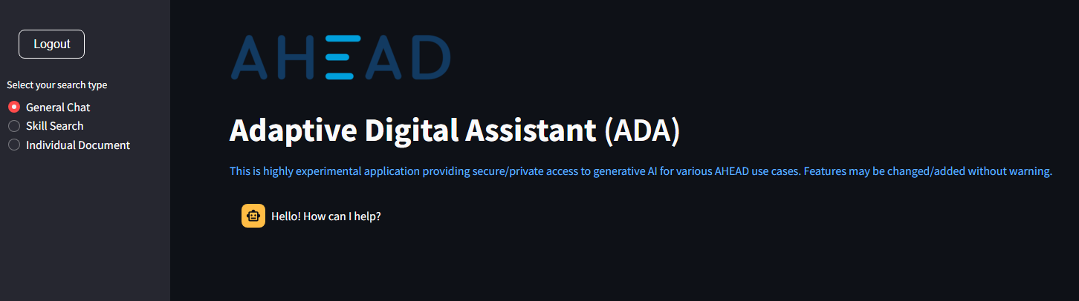
Inhouse AHEAD R&D Example
The first iteration determined the context by the prompt, but users were not very good at writing prompts, so in the second version we made them use a radio button.

Slide 21
Spring AI
02
Spring AI simplifies AI for Java Developers

Slide 22


Spring AI Inspiration
“The project was founded with the belief that the next wave of Generative AI applications will not be only for Python developers but will be ubiquitous across many programming languages.”
Spring AI Reference Overview
Image credit: Pavan Bellagatti
Image credit: Kyle Tobin

Slide 23
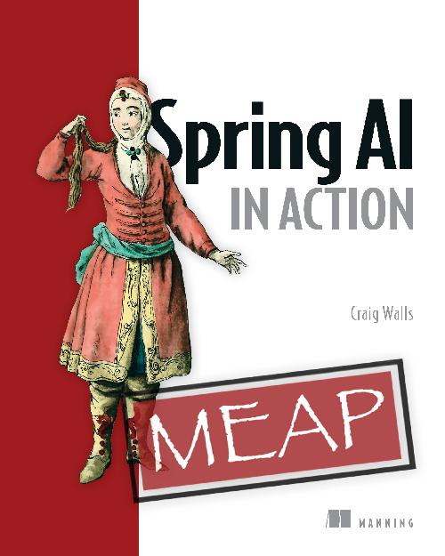
Spring AI in Action
https://www.manning.com/books/spring-ai-in-action

Slide 24
You don’t need to be a data scientist to use AI in your Spring applications
…but you will need data engineers to help with the ETL, just like you rely on DBAs and System Admins today.

Slide 25
Demo 1
Switch between GPT-4o and Groq with zero changes in Java
. ./.env
mvn -Popenai spring-boot:run -Dspring-boot.run.jvmArguments="-Dspring.profiles.active=gpt-4o"
mvn -Popenai spring-boot:run -Dspring-boot.run.jvmArguments="-Dspring.profiles.active=groq"
http ":8080/chat?message=Tell me a dad joke about animals?"
Notes:
Simple chat, with multiple LLMs, without changing code.

Slide 26
Why not call the API directly?
http POST https://api.openai.com/v1/chat/completions \
Content-Type:application/json \
Authorization:"Bearer $OPENAI_API_KEY" \
model=gpt-4o messages:='[{"role": "user",
"content": "When was the Apple II released?"}]'

Slide 27
Spring AI is just another Spring integration

Slide 28
Spring Data Access/Integration
JDBC
ORM
XML
Spring JDBC
Spring JPA
Spring OXM
JMS
TXN
AI
Spring JMS
Transactions
Spring AI
A JDBC-abstraction layer
Integration layers for JPA, JDO, and Hibernate
Abstraction layer for Object/XML mapping
Features for producing & consuming messages
Programmatic and declarative transactions
Portable AI support across providers

Slide 29
Spring AI Architecture
Abstractions
Portable Chat Client
Uses component abstractions and defaults Implementations
Portable chat completion and embedding client
Multimodality
Portable Vector Store
Work with audio, images, or text as input or output
Portable vector store API and query language to embed your own data
Function Calling
ETL Framework
AI model to invoke a function that enhances the LLM
Used to “bring your data." Leverages java.util.function

Slide 30
Spring AI Prompt
public String ask(String message) {
return chatClient.prompt()
.user(message)
.system(“Your job is customer…”)
.call()
.content();
}

Slide 31
Spring AI Prompt Template
Context
Prompt Templates
Substitute parts of the request with values relative to user’s query
Similar to LlamaIndex PromptTemplates. Spring AI uses StringTemplates just like Spring MVC templates.
PromptTemplate promptTemplate = new PromptTemplate("""
Tell me a {adjective} joke about {topic}.
""");
Prompt prompt = promptTemplate.create(Map.of(
“adjective”, adjective, “topic”, topic)}

Slide 32
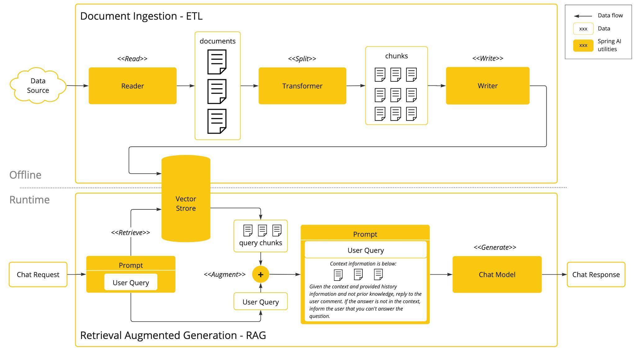
Retrieval-Augmented Generation
Image Credit: Spring AI Reference - RAG

Slide 33
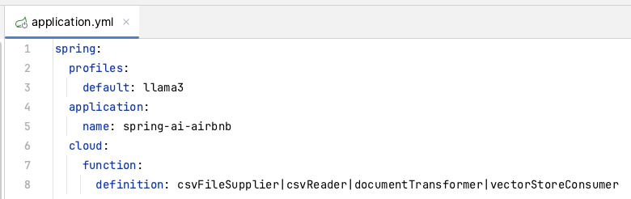
Spring AI ETL Functions Definition
Spring AI ETL uses Spring Cloud functions. Here, the "spring.cloud.function.definition" properties shows a pipe delimited list of function beans.

Slide 34
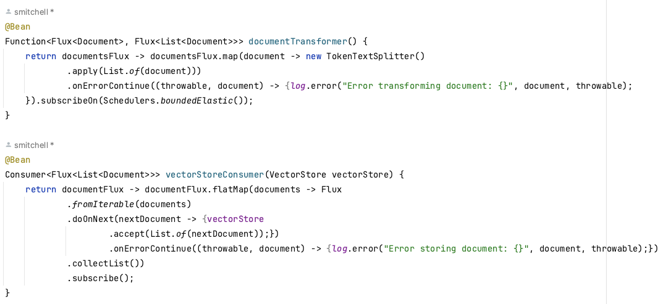
Spring AI ETL Function Examples

Slide 35
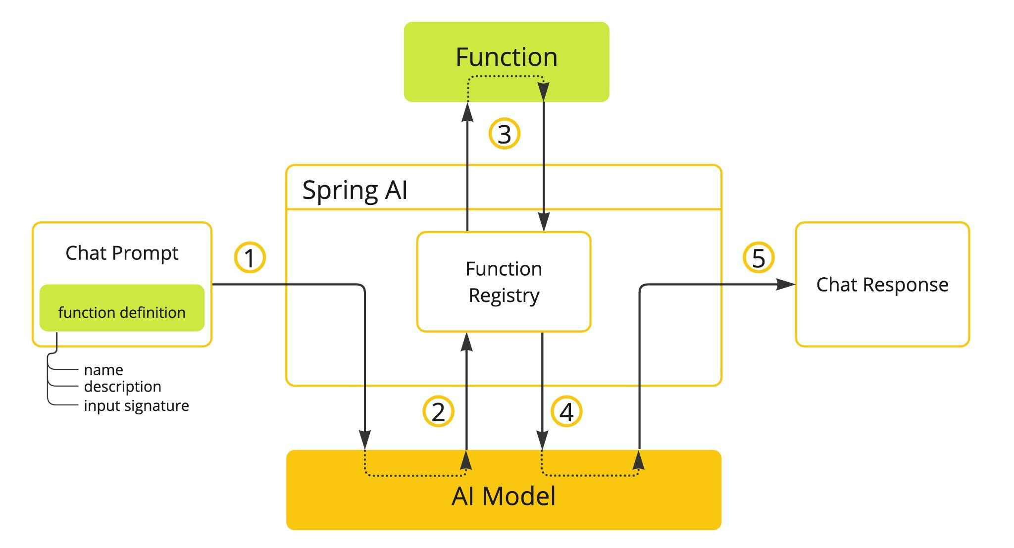
Spring AI Function Calling
Christian Tzolov. "Spring AI with Ollama Tool Support." Spring Blog, 26 July 2024, https://spring.io/blog/2024/07/26/spring-ai-with-ollama-tool-support.

Slide 36
Function Callbacks
OpenAiChatModel chatModel = ...
UserMessage userMessage = new UserMessage("What's the weather like in San Francisco, Tokyo, and Paris?");
var promptOptions = OpenAiChatOptions.builder()
.withFunctionCallbacks(List.of(new FunctionCallbackWrapper<>(
"CurrentWeather", // name
"Get the weather in location", // function description
new MockWeatherService()))) // function code
.build();
ChatResponse response = chatModel.call(new Prompt(List.of(userMessage), promptOptions));
https://docs.spring.io/spring-ai/reference/api/chat/functions/openai-chat-functions.html

Slide 37
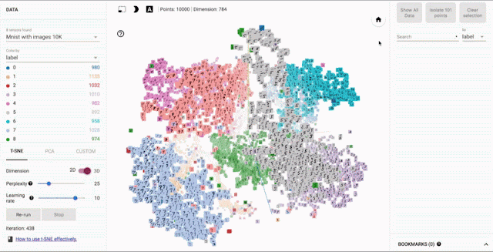
Spring AI Portable Vector Store
Support for Vector Database:
Apache Cassandra
Azure Vector Search
Chroma
Milvus
MongoDB Atlas
Neo4j
Oracle
PostgreSQL/PGVector
PineCone
Qdrant
Redis
Weaviate
Image credit: Open sourcing the Embedding Projector: a tool for visualizing high dimensional data

Slide 38
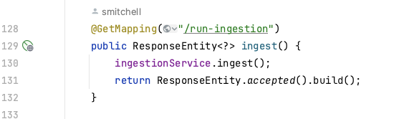
Embedding Data
This project has an endpoint for embedding data in the AirbnbController class.
The ingestion service reads the 15,000 listings in a CSV file and creates embeddings in the vector store, as shown on the next slide.

Slide 39
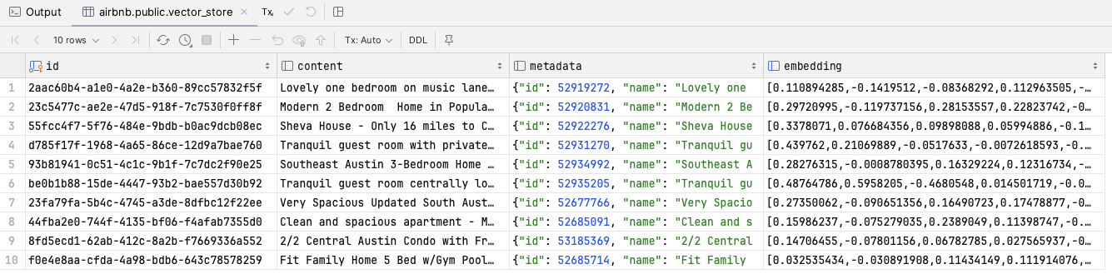
Embedded Data
The content column is the string used to populate the embedding column.
The metadata is informational and has no bearing on the vector embedding or searching.

Slide 40
Ollama
03
How Ollama makes it easy to run AI locally.

Slide 41

Use Ollama to Run LLMs Locally
Ollama is to LLMs what VirtualBox is to VMs or Docker is to containers
Ollama is an open source platform that runs LLMs (Large Language Models) on your machine.
Supports Windows, MacOS, and Linux
Docker image: https://hub.docker.com/r/ollama/ollama
Supports Llama 3, Phi 3, Mistral, Gemma 2, …
Visit https://ollama.com/ to learn more

Slide 42
Running the Ollama Docker Image
https://hub.docker.com/ollama/ollama
Ollama runs without a GPU, but very slowly
If you use a laptop, consider hosting Ollama on another computer that has a suitable GPU
docker run -d -v ollama:/root/ollama \
-p 11434:11434 -–name ollama \
ollama/ollama

Slide 43
Using Ollama in Terminal mode
docker exec -it ollama ollama run llama3
>>> tell me a joke
Why don't scientists trust atoms?
Because they make up everything!
Hope that made you smile! Do you want to hear another one?
>>> /bye

Slide 44
Demo 2
Call Llama 3.1 running locally on Ollama with zero code changes
mvn spring-boot:run
. ./.env
http ":8080/chat?message=When did the Apple II come out"

Slide 45

Use a GPU if at all Possible
NVidia Cuda GPUs: https://developer.nvidia.com/cuda-gpus
AMD Radeon GPUs
Llama3 recommends an Nvidia GeForce 3000-series or higher
See the full list of GPUs supported by Ollama: https://github.com/ollama/ollama/blob/main/docs/gpu.md

Slide 46
Spring AI Demo
04
Hands on with Spring AI and Ollama

Slide 47
Demo 3
Spin up a Spring AI project in less than 10 minutes with properties and a single controller

Slide 48
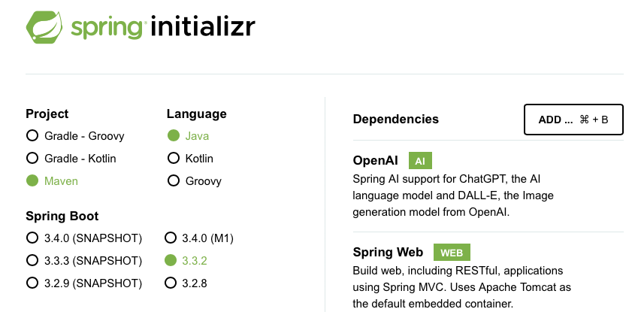
Create a Spring AI Project

Slide 49
Update application.yaml
spring:
application:
name: demo
ai:
openai:
api-key: ${OPENAI_API_KEY}
chat:
options:
model: gpt-4o

Slide 50
Invoke the Chat Client
@RestController
public class ChatController {
private final ChatClient chatClient;
public ChatController(ChatClient.Builder builder) {
this.chatClient = builder.build();
}
@GetMapping("/chat")
public String simplePrompt(@RequestParam String message) {
return chatClient.prompt()
.user(message)
.call().content();
}
}

Slide 51
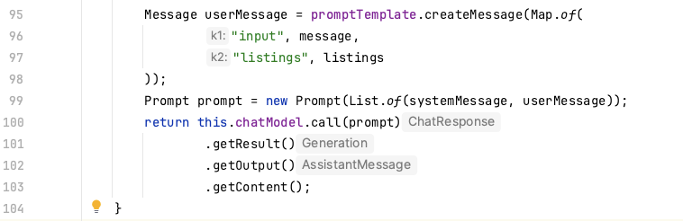
Prompt Stuffing
For non-vector store data, use prompt stuffing to put data into the prompt along with the user's question.
This example assumes that "listings" come from a company database.

Slide 52
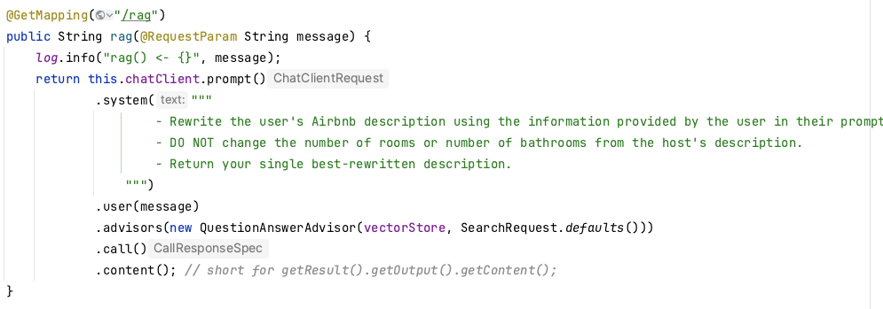
Retrieval-Augmented Generation
For RAG, if your company data embeddings are in a vector store, you can pass in the vector store. See demo 4.

Slide 53
Demo 4
Rewrite AirBnb Listing using Retrieval-augmented Generation
. ./.env
mvn spring-boot:run
http ":8080/rag?message=2-bedroom 2-bathroom close to downtown Austin"
Notes:
Cover as many of the use cases as time allows here.

Slide 54
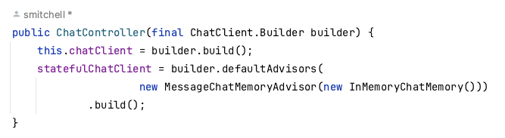
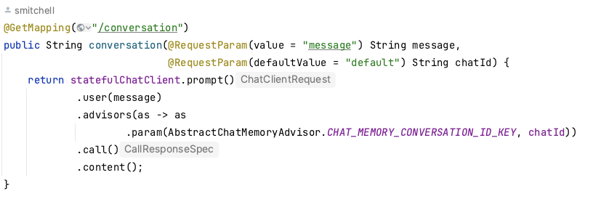
Stateful Converatations

Slide 55
Demo 5
Hold conversational state in an in-memory vector store
. ./.env
mvn -Popenai spring-boot:run -Dspring-boot.run.jvmArguments="-Dspring.profiles.active=gpt-4o"
http ":8080/conversation?message=When did the Apple II come out?&chatId=1234"
http ":8080/conversation?message=What other computers came out that year?&chatId=1234"
Notes:
Cover as many of the use cases as time allows here.

Slide 56
Function Callbacks
OpenAiChatModel chatModel = ...
UserMessage userMessage = new UserMessage("What's the weather like in San Francisco, Tokyo, and Paris?");
var promptOptions = OpenAiChatOptions.builder()
.withFunctionCallbacks(List.of(new FunctionCallbackWrapper<>(
"CurrentWeather", // name
"Get the weather in location", // function description
new MockWeatherService()))) // function code
.build();
ChatResponse response = chatModel.call(new Prompt(List.of(userMessage), promptOptions));
https://docs.spring.io/spring-ai/reference/api/chat/functions/openai-chat-functions.html

Slide 57
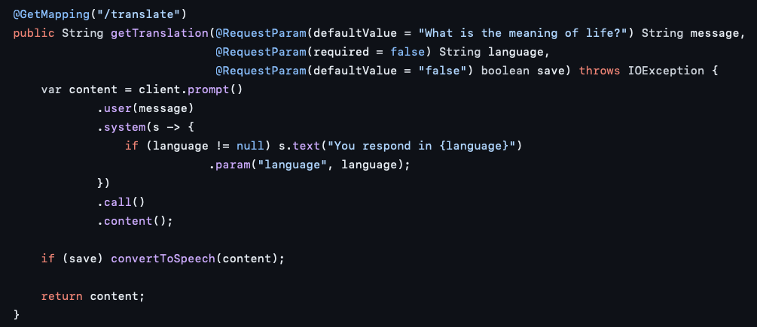
Language Translation
https://github.com/mkheck/ai202/blob/main/src/main/java/com/thehecklers/ai202/Ai202Controller.java

Slide 58
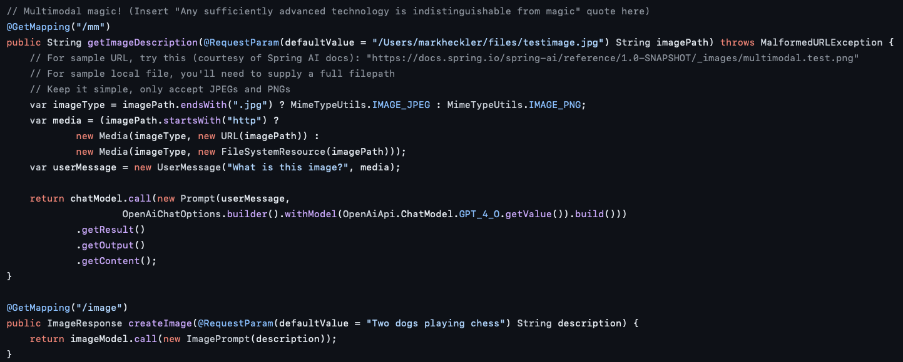
Multimedia
https://github.com/mkheck/ai202/blob/main/src/main/java/com/thehecklers/ai202/Ai202Controller.java

Slide 59
Conclusion
05
Your path forward with Spring AI

Slide 60
When to use AI in your applications?
Don't believe all the hype about generative AI.
Take full advantage of vendor AI integrations in the tools you use.
Choose generative AI for complex, unstructured data and enhanced user experience.
Choose SQL queries for structured data and lower initial costs.
Including RAG in your application can significantly enhance information access, improve user experience, and increase efficiency and productivity.

Slide 61

Resources
Spring AI Reference
Dan Vega’s AI Playlist
https://docs.spring.io/spring-ai/reference/
https://www.youtube.com/watch?v=yyvjT0v3lpY&list=PLZV0a2jwt22uoDm3LNDFvN6i2cAVU_HTH&pp=iAQB

Slide 62
Thanks!
Do you have any questions?
Please reach out to me if you have any questions.
stevecmitchell@gmail.com
913-485-6194
https://smitchell.github.io

